Slide 1
Developing dynamic web pages using Servlets
COURSE OVERVIEW

Slide 2
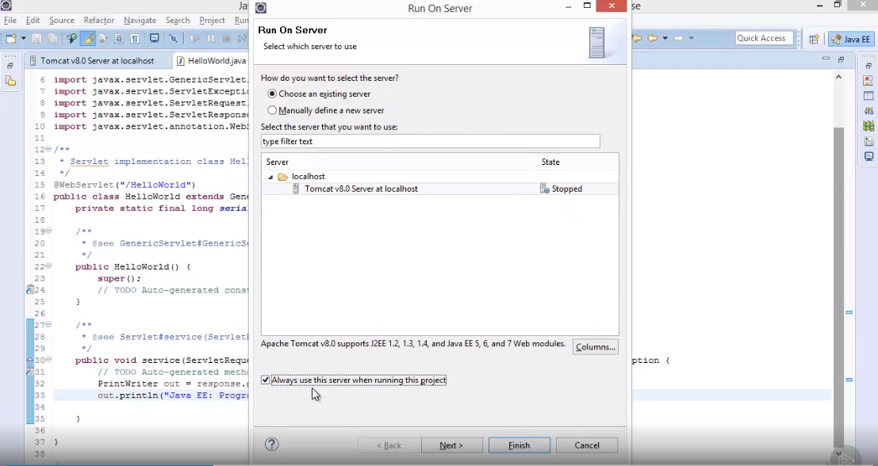

Slide 5
